Slide 1
Registers
Reference
Chapter 7
Moris Mano 4th Edition

Slide 2
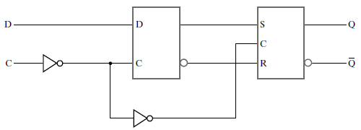


Positive-Edge-Triggered D Flip-Flop
D | Q(t+1) | Operation
0 | 0 | Reset
1 | 1 | Set
Characteristic Table
Graphic Symbol
Clock

Slide 3
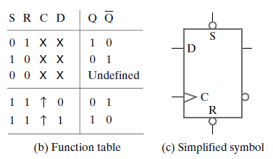
D Flip-Flop with Direct Inputs
Independent
Of clock
Clock
Notes:
( S , R ) = (0,1) → Bubbles at S and R inputs → ( 1 , 0 ) coming in the flip-flop → save 1 asynchronously
Reference: Page 221 Moris Mano 4th Edition

Slide 4
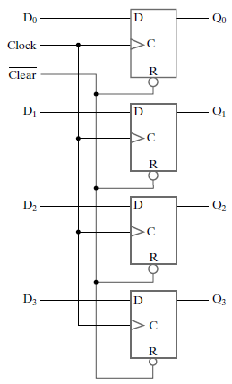
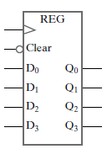
4-bit Register with parallel load
Symbol
Register Contents:
Q3 | Q2 | Q1 | Q0
Logic Diagram
Notes:
Page 337 Moris Mano 4th Edition

Slide 5
4-bit Register with parallel load
4 Flip-Flops
connected with
one clock
Reset functionality
for Register
(initialization)
to set all 4 bits
to zero (irrespective
of clock signal) i.e.
Symbol
0 | 0 | 0 | 0
Q3 | Q2 | Q1 | Q0
Logic Diagram

Slide 6
How 4-bit Register works?
What if we connect
Clock to first two
Flip-flops and
(Clock)’ to last
Two flip-flops?
Clock

Slide 7
Register Load
Register Load:
“Transfer of new information into a register”
Parallel Loading:
All the bits of register loaded simultaneously with a common clock pulse

Slide 8
Register Load
Problem:
Keep the data saved until user wants to change it i.e. Do not update contents with clock.
Solution:
Update register functionality such that:
Load = 0 → Content unchanged even with clock
Load = 1 → Follow the clock to change the contents

Slide 9
Register Load
Methods to control Register Load:
Load control with Clock Gating
Clock Gating: Prevent clock from reaching the flip-flops
Load control with D Input

Slide 10

1. Load Control with Clock Gating
C Input

Slide 11
1. Load Control with Clock Gating
Cinput = Load ’ + Clock
Load = 1:
Cinput = 0 + Clock
Cinput = Clock (X + 0 = X)
- Register is clocked normally
- New information is transferred into the register on positive edge of clock

Slide 12
1. Load Control with Clock Gating
Cinput = Load ’ + Clock
Load = 0:
Cinput = 1 + Clock
Cinput = 1
- Clock has been stopped to enter Flip-Flop
- No positive transitions on C Inputs, contents of registers remain unchanged

Slide 13
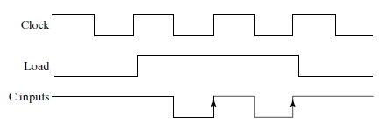
1. Load Control with Clock Gating
C Input
Clock stopped
Behind the gate
Clock being passed
To register

Slide 14
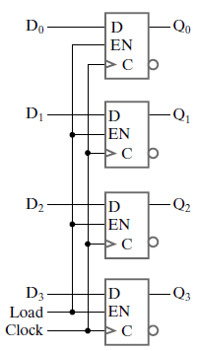
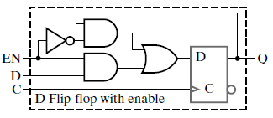

2. Load Control with D Input
Clock

Slide 15
2. Load Control with D Input
Enable
Clock

Slide 16
2. Load Control with D Input

Slide 17
2. Load Control with D Input
Requirement: Enable = 0 → Flip Flop Disabled → Retain Q
1
Q
Q
0
0
0
X . 0 = 0
X . 1 = X

Slide 18
2. Load Control with D Input
Requirement: Enable = 1 → Flip Flop Enabled → Save Data D
0
0
D
1
1
D
X . 0 = 0
X . 1 = X

